Slide 1
Comparing Circuits

Slide 2

By the end of this lesson you will be able to:
Compare key features of series and parallel circuits.
Describe how light bulb brightness varies in different types of circuits.
Explain how switches work in series and parallel circuits.

Slide 3
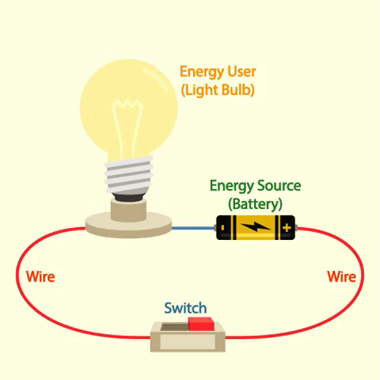
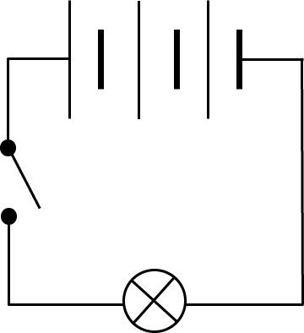
The two types of circuits are series circuits and parallel circuits.
A series circuit forms a single loop. All of the components are in a line.

Slide 4
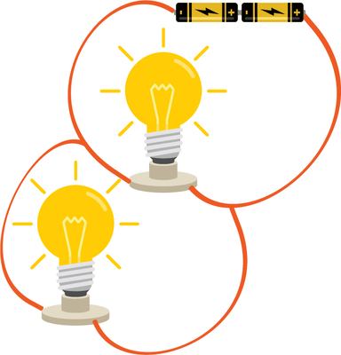
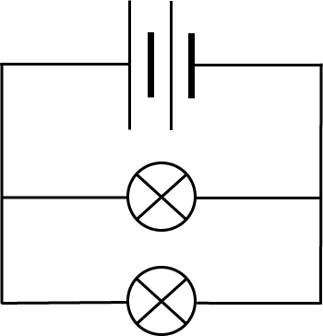
A parallel circuit has multiple branches.
Each branch has circuit components on it.

Slide 5
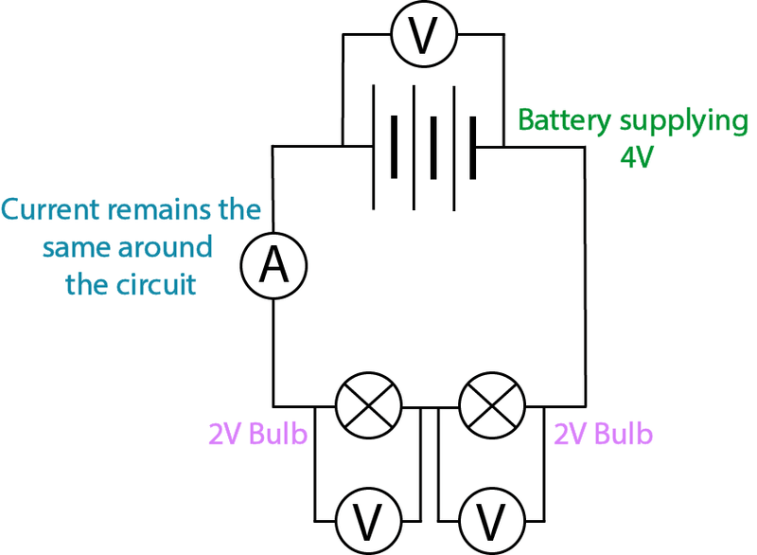
Voltage and current behave differently in series circuits and parallel circuits.
In series circuits, each component has the same current through them. This is because there is only one path for the current to flow along.
However, voltage is split up in series circuits. The voltage across each component depends on the resistance of the component.

Slide 6
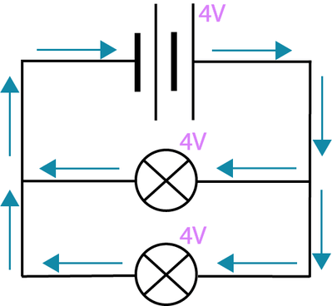
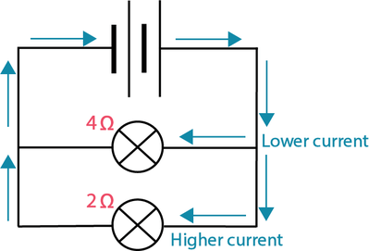
Current and voltage behave differently in parallel circuits.
Branches in parallel circuits have the same voltage across them.
However, the current is split up in these circuits. This is because there are multiple paths for the current to flow down, but each electron can only go down one branch at a time.

Slide 7

Voltage strength is pretty important for circuit components.
The brightness of a light bulb depends on the voltage across it. A larger voltage results in a brighter light bulb.

Slide 8

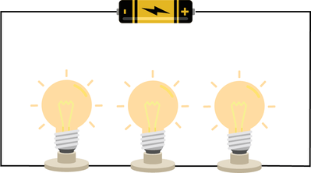
Voltage is split up in series circuits.
This means that if light bulbs are connected in series they will get dimmer as more light bulbs are added.
For example, a single light bulb is brighter than three light bulbs collected in series.

Slide 9

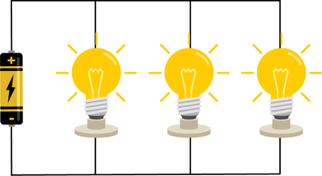
In parallel circuits, every branch receives the same voltage.
This means that you can add more light bulbs and their brightness is not affected.

Slide 10
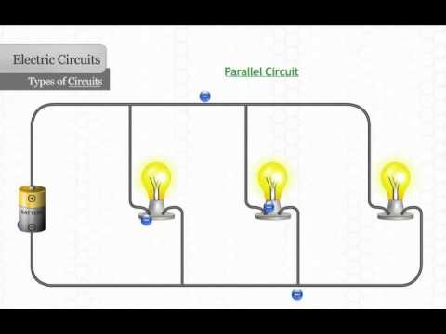

Slide 11

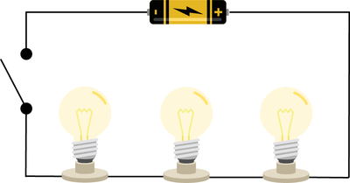
We can add switches into series and parallel circuits.
If you open a switch in a series circuit, it will turn all the light bulbs off. The light bulbs cannot be controlled individually and the series circuit has been broken.

Slide 12
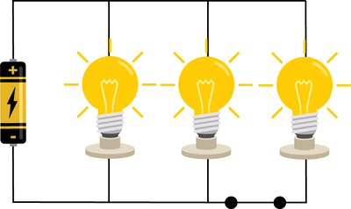
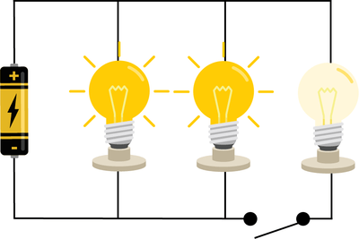
In parallel circuits, the light bulbs can be controlled individually.
This is because a switch on a branch will only control the light bulb on that branch.

Slide 13
